Slide 1
RESUME CLASSIFICATION
GUIDED BY:
PRESENTED BY:
Mahesh Renkuntla
Hithindra
Manikandan C
Shreyansh Gaurkar
Shubham Kapadne
Nikhil Hosamani
Aditya Rao

Slide 2


INTRODUCTION RESUME CLASSIFICATION
Resume Classification are programs designed to scan the document, analyze it and extract information important to recruiters. For most HR professionals, important information to be extracted with a resume classification includes skills, work experience, contact information, achievements, education, certifications and certain professional specializations.

Slide 3
OBJECTIVE
Resume classification is a technology that allows you to process online resumes and structure the information by extracting data in an intelligent way. It helps recruiters to efficiently manage electronic resume documents sent via the internet. It extracts essential information like: Contact information, Experience, Skills.
The document classification solution should significantly reduce the manual human effort in the HRM. It should achieve a higher level of accuracy and automation with minimal human intervention
Objective describing position you seek. Profile giving summary of your talents and experience. Experience listing your position, employer and dates.

Slide 4
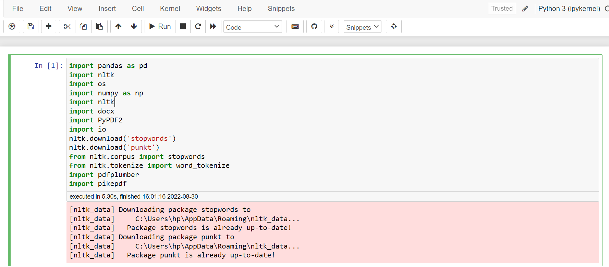
So start with we have to install all the required libraries:

Slide 5
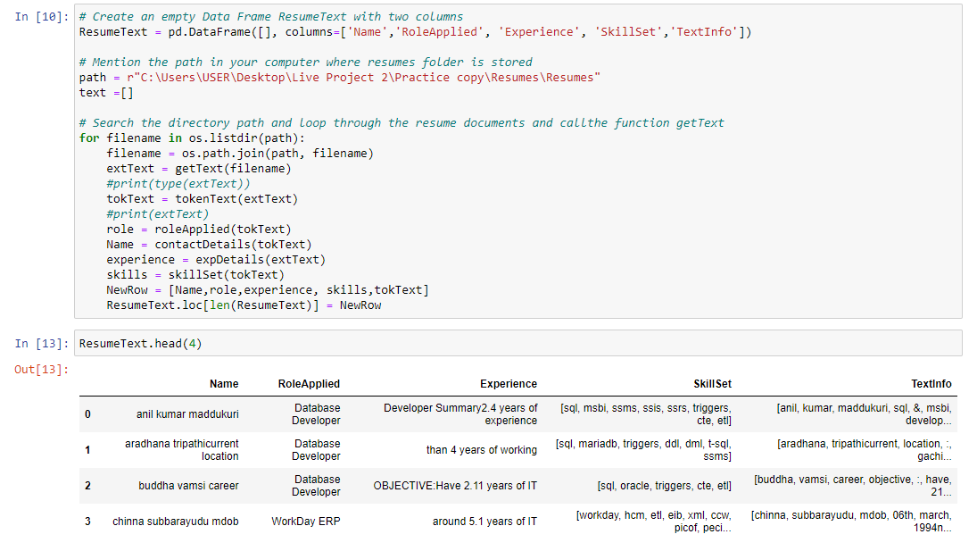
Exploratory Data Analysis (EDA) & Visualization

Slide 6
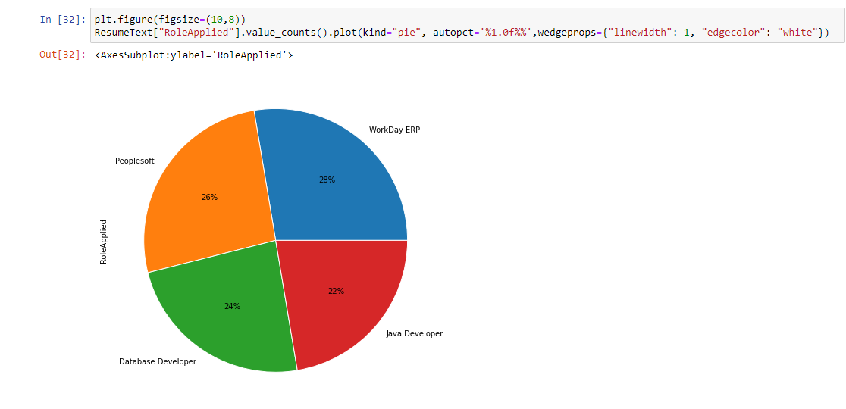
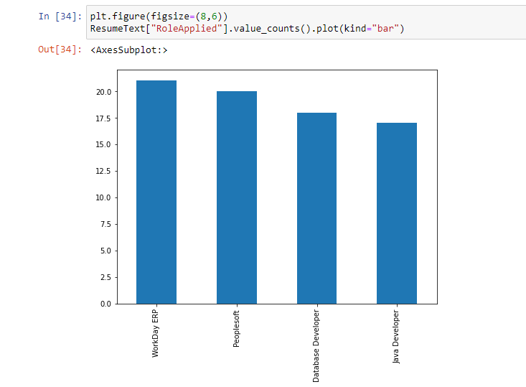

Slide 7
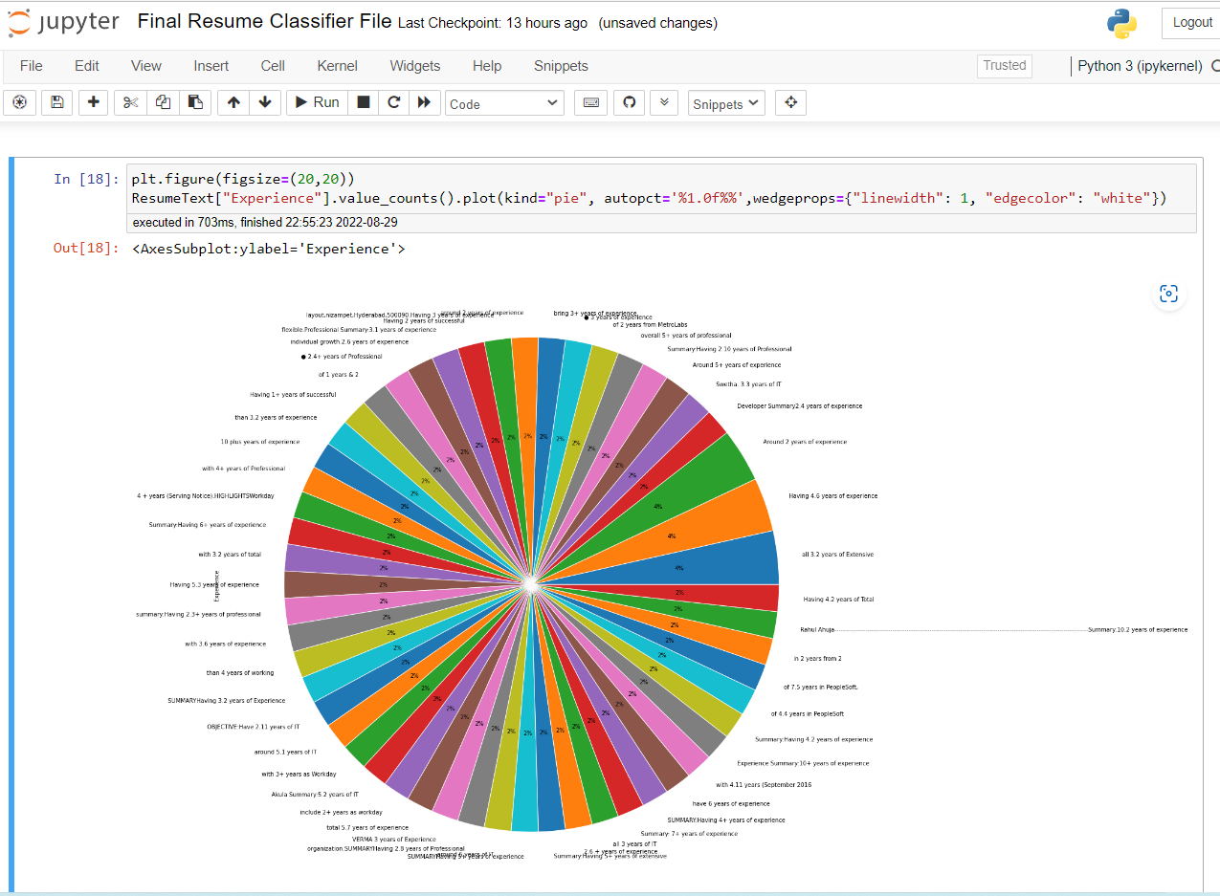

Slide 8
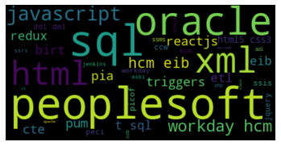
Visualization Generate Word Cloud

Slide 9

Model Building

Slide 10
List of Models Created
K-NEAREST NEIGHBOUR (KNN) CLASSIFICATION
SUPPORT VECTOR MACHINE (SVM) CLASSIFICATION
NAIVE BAYES CLASSIFICATION
DECISION TREE CLASSIFICATION
RANDOM FOREST CLASSIFICATION
Various Models

Slide 11
Random Forest Classification :
Random forest is an ensemble learning method for classification, regression and other tasks that operates by constructing a multitude of decision trees at training time.
2. K-Nearest Neighbour (KNN) Classification :
KNN is a non-parametric, supervised learning classifier, which uses proximity to make classifications or predictions about the grouping of an individual data point.
3. Support Vector Machine (SVM) Classification :
Support Vector Machine(SVM) is a linear model for classification and regression problems. It can solve linear and non-linear problem and work well for many practical problems

Slide 12
4. Naive Bayes Classification :
The Naive Bayes Classification is a probabilistic classifier. It based on probability models that incorporate strong independence assumptions. The independence assumptions often do not have an impact ono reality. Therefore they are considered as naïve.
Decision Tree Classification :
Decision Tree builds classification or regression models in the form of a structure. It breaks down a dataset into a smaller and smaller subsets while at the same time an associated decision tree is incrementally developed.

Slide 13
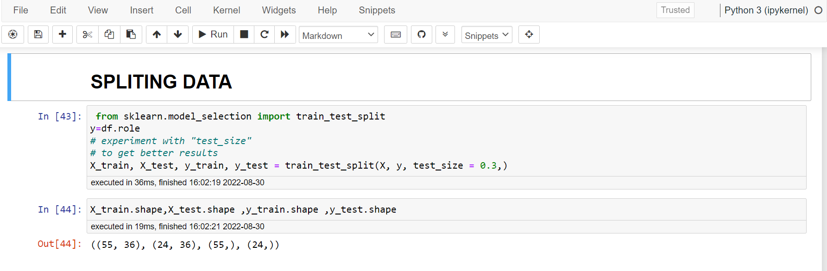
SPLTITING DATA

Slide 14
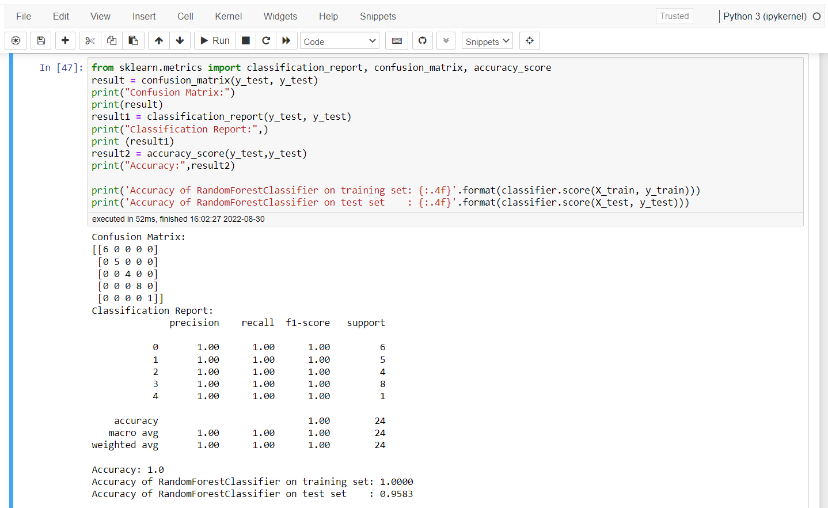
Selected Model : Random Forest Classification
Random forest gives the best accuracy compare to remaining four models
Accuracy of random forest classifier on training set: 1.0000
Accuracy of random forest classifier on test set : 0.9583

Slide 15
DEPLOYMENT
Stream lit is an app framework to deploy machine learning apps built using Python.
Stream lit was used for deployment of model.

Slide 16
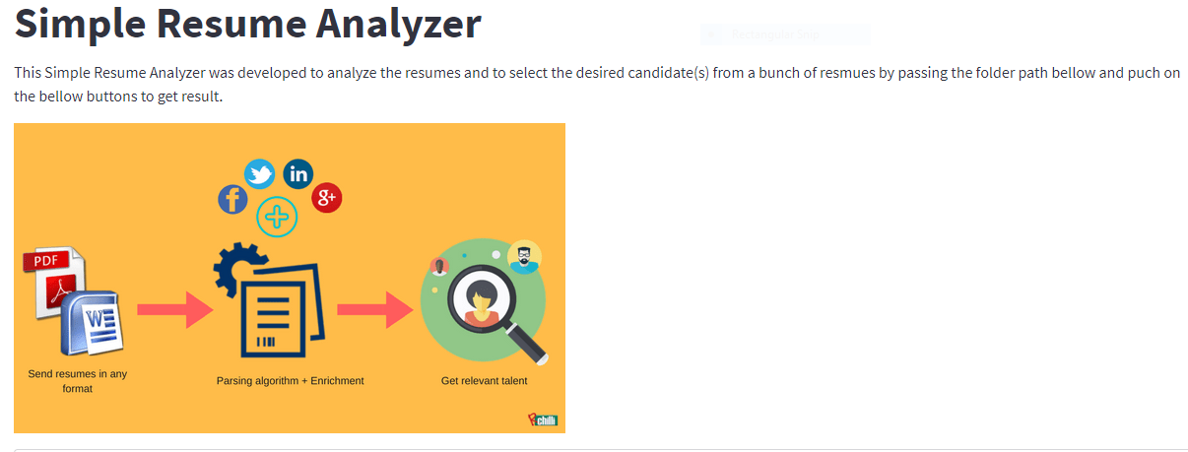
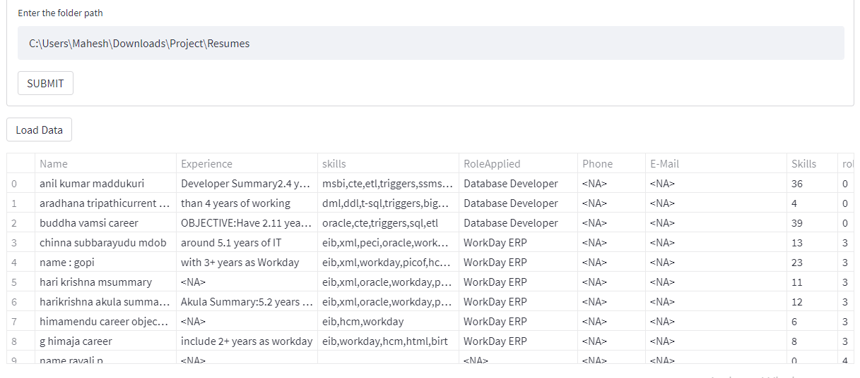
SELECTING FILE IN THE FOLDER

Slide 17
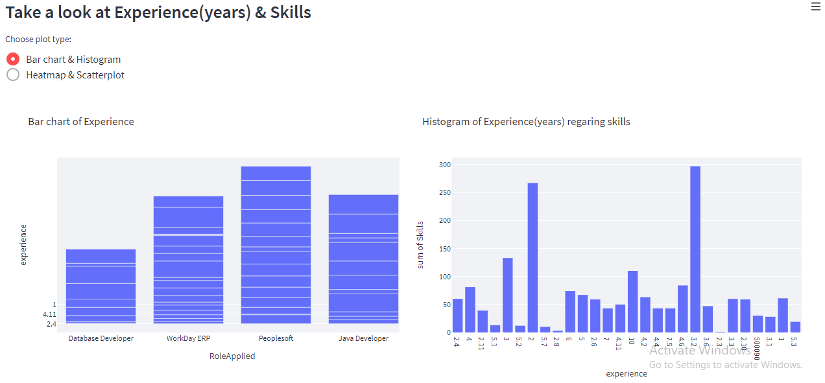

Slide 18
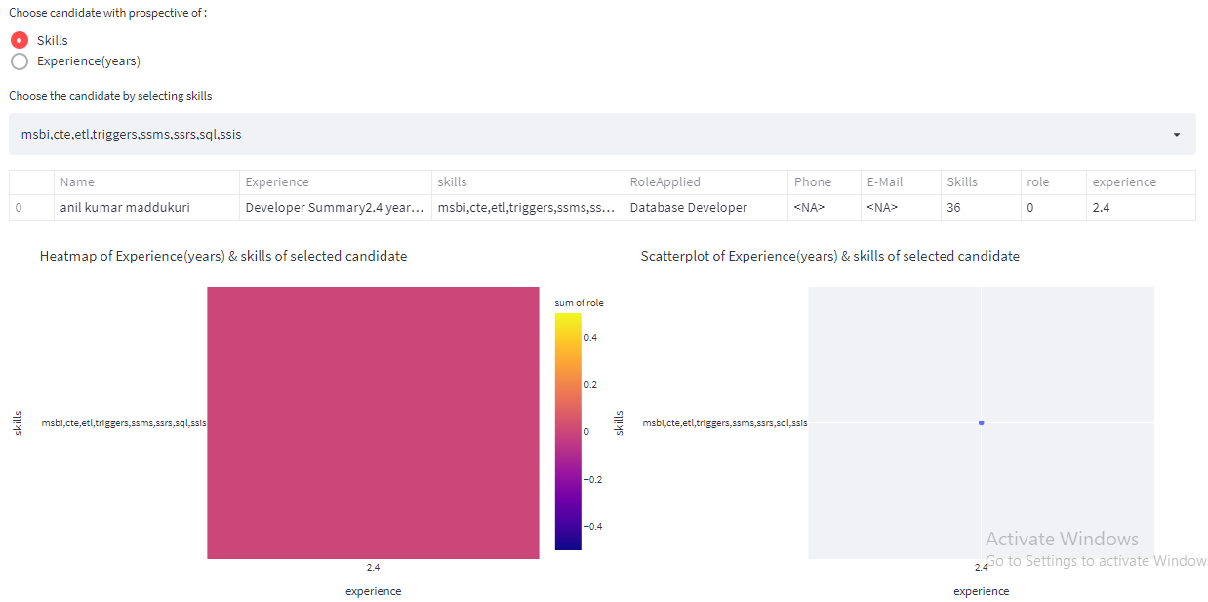

Slide 19
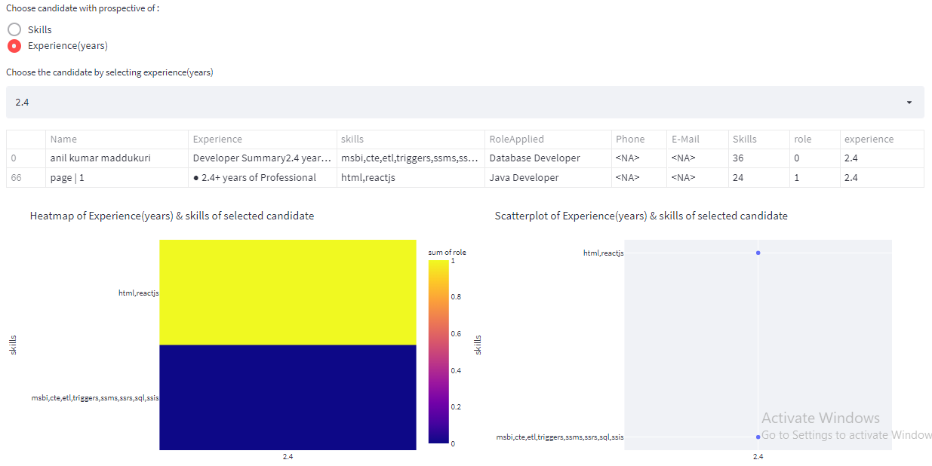

Slide 20

THANK YOU

